Slide 1

Why Waze users churn?
Machine learning models and logistic regression-based analysis

Slide 2
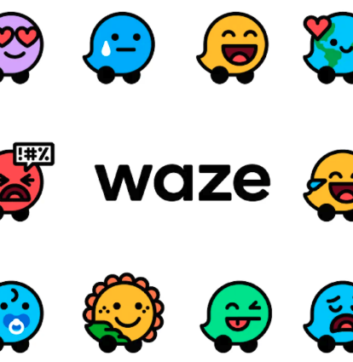
Overview
Identify patterns that lead to user churn.
By leveraging a dataset of 14,999 users, I developed machine learning models to predict which users are likely to stop using the Waze app, allowing for targeted retention strategies.
Driving frequency is the biggest predictor.

Slide 3

Problem
Challenge: Waze faces difficulties in distinguishing between casual users and those at high risk of churning.
The core problem is identifying more complex behavioral “tipping points”.

Slide 4

Solution
I implemented logistic regression and two ensemble tree-based models: Random Forest and XGBoost.
To boost performance, I engineered new features like km_per_driving_day and percent_sessions_in_last_month to better represent user intensity and recent engagement levels.

Slide 5
Details
1. Logistic Regression
The Approach: I established a binomial logistic regression model. This was used to identify which specific variables—like activity_days and driving_days—have a statistically significant impact on churn.
Key Finding: The logistic model revealed that for every additional day a user is active in the app, the odds of churning decrease significantly. However, the model's overall recall was low, indicating that linear relationships alone couldn't catch all churners.

Slide 6
Details (conti.)
2. Advanced Modeling (Random Forest & XGBoost)
The Approach: To improve on the baseline, we implemented ensemble models. We split the data into Training, Validation, and Test sets to ensure the model could generalize to new users.
Feature Engineering: We added "intensity" metrics to give the model more context:
km_per_driving_day: Distinguishes between long-distance commuters and short-trip casual users.
professional_driver: A binary indicator for high-volume users (60+ drives and 15+ days active).
percent_sessions_in_last_month: Measures if a user’s engagement is increasing or decreasing relative to their history.

Slide 7

Details (conti.)
3. Model Evaluation & Metrics
Champion Model: XGBoost was selected as the superior model because of its ability to handle imbalanced data and complex interactions.
Success Metric: We prioritized Precision and Recall over simple Accuracy.
  Precision: Ensures we don't waste marketing budget on users who weren't going to churn.
  Recall: Ensures we catch as many "at-risk" users as possible before they leave.

Slide 8
Ethical & Practical Constraints
The "Spam" Risk: We identified that a high false-positive rate could lead to "notification fatigue." If Waze proactively targets users with "Come back!" messages too early, it might actually annoy them into deleting the app.
Data Limitations: The details show that while the models are mathematically sound, churn is often driven by external factors (e.g., a new road opening, gas prices, app technical performance) not currently in the dataset.

Slide 9

Next Steps
Phase 1: Pilot A/B Testing (Immediate)
We propose a controlled experiment to validate the model's ROI.
Segment: Users identified by the XGBoost model with a churn probability score of >0.75.
Action: Randomized 50/50 split. The test group will receive a "Value-Add" push notification (e.g., fuel price alerts or personalized traffic summaries), while the control group receives standard engagement.
Goal: Measure the "lift" in retention over a 30-day window to calculate the financial value of the model.

Slide 10

Next Steps Phase 2: Bridging the "Signal Gap" (Data Strategy)
Our analysis revealed that while driving frequency is a strong predictor, there is a "signal gap" in understanding why users leave. We recommend integrating the following data points into Version 2.0 of the model:
App Stability Metrics: Tracking crash rates and latency per user session.
Engagement Events: User interaction with "Report" features (Police, Accident, Hazard).
External Factors: Localized gas price fluctuations and competitor app release dates.

Slide 11
Model Improvements
Recency-weighted features
Feature intersections / Interaction terms
Macroeconomic indicators (Gas price fluctuations)
Competitive landscape analysis
Seasonality adjustments
Class imbalance handling & model stacking
Technical telemetry & granular behavioral data

